Slide 1
Software Engineering | Capability maturity model (CMM)

Slide 2
CMM was developed by the Software Engineering Institute (SEI) at Carnegie Mellon University in 1987.
It is not a software process model. It is a framework that is used to analyze the approach and techniques followed by any organization to develop software products.
It also provides guidelines to further enhance the maturity of the process used to develop those software products.
It is based on profound feedback and development practices adopted by the most successful organizations worldwide.
This model describes a strategy for software process improvement that should be followed by moving through 5 different levels.
Each level of maturity shows a process capability level. All the levels except level-1 are further described by Key Process Areas (KPA’s).

Slide 3
Shortcomings of SEI/CMM:
It encourages the achievement of a higher maturity level in some cases by displacing the true mission, which is improving the process and overall software quality.
It only helps if it is put into place early in the software development process.
It has no formal theoretical basis and in fact is based on the experience of very knowledgeable people.
It does not have good empirical support and this same empirical support could also be constructed to support other models.

Slide 4
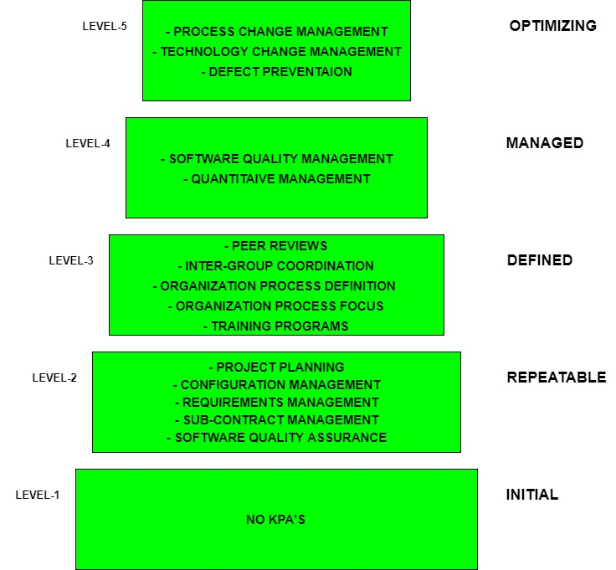

Slide 5
The 5 levels of CMM are as follows:
Level-1: Initial –
No KPA’s defined.
Processes followed are Adhoc and immature and are not well defined.
Unstable environment for software development.
No basis for predicting product quality, time for completion, etc.
Level-2: Repeatable –
Focuses on establishing basic project management policies.
Experience with earlier projects is used for managing new similar natured projects.
Project Planning- It includes defining resources required, goals, constraints, etc. for the project. It presents a detailed plan to be followed systematically for the successful completion of good quality software.
Configuration Management- The focus is on maintaining the performance of the software product, including all its components, for the entire lifecycle.

Slide 6
Requirements Management- It includes the management of customer reviews and feedback which result in some changes in the requirement set. It also consists of accommodation of those modified requirements.
Subcontract Management- It focuses on the effective management of qualified software contractors i.e. it manages the parts of the software which are developed by third parties.
Software Quality Assurance- It guarantees a good quality software product by following certain rules and quality standard guidelines while developing.
Level-3: Defined –
At this level, documentation of the standard guidelines and procedures takes place.
It is a well-defined integrated set of project-specific software engineering and management processes.
Peer Reviews- In this method, defects are removed by using a number of review methods like walkthroughs, inspections, buddy checks, etc.

Slide 7
Intergroup Coordination- It consists of planned interactions between different development teams to ensure efficient and proper fulfillment of customer needs.
Organization Process Definition- Its key focus is on the development and maintenance of the standard development processes.
Organization Process Focus- It includes activities and practices that should be followed to improve the process capabilities of an organization.
Training Programs- It focuses on the enhancement of knowledge and skills of the team members including the developers and ensuring an increase in work efficiency.

Slide 8
Level-4: Managed –
At this stage, quantitative quality goals are set for the organization for software products as well as software processes.
The measurements made help the organization to predict the product and process quality within some limits defined quantitatively.
Software Quality Management- It includes the establishment of plans and strategies to develop quantitative analysis and understanding of the product’s quality.
Quantitative Management- It focuses on controlling the project performance in a quantitative manner.

Slide 9
Level-5: Optimizing –
This is the highest level of process maturity in CMM and focuses on continuous process improvement in the organization using quantitative feedback.
Use of new tools, techniques, and evaluation of software processes is done to prevent recurrence of known defects.
Process Change Management- Its focus is on the continuous improvement of the organization’s software processes to improve productivity, quality, and cycle time for the software product.
Technology Change Management- It consists of the identification and use of new technologies to improve product quality and decrease product development time.
Defect Prevention- It focuses on the identification of causes of defects and prevents them from recurring in future projects by improving project-defined processes.

Slide 10
Personal Software Process (PSP)

Slide 11
Personal Software Process (PSP) is the skeleton or the structure that assist the engineers in finding a way to measure and improve the way of working to a great extend. It helps them in developing their respective skills at a personal level and the way of doing planning, estimations against the plans.
Objectives of PSP : The aim of PSP is to give software engineers with the regulated methods for the betterment of personal software development processes. The PSP helps software engineers to:
Improve their approximating and planning skills.
Make promises that can be fulfilled.
Manage the standards of their projects.
Reduce the number of faults and imperfections in their work.

Slide 12
Time measurement: Personal Software Process recommend that the developers should structure the way to spend the time. The developer must measure and count the time they spend on different activities during the development.
PSP Planning : The engineers should plan the project before developing because without planning a high effort may be wasted on unimportant activities which may lead to a poor and unsatisfactory quality of the result.

Slide 13
Levels of Personal Software Process : Personal Software Process (PSP) has four levels-
PSP 0 – The first level of Personal Software Process, PSP 0 includes Personal measurement , basic size measures, coding standards.
PSP 1 – This level includes the planning of time and scheduling .
PSP 2 – This level introduces the personal quality management ,design and code reviews.
PSP 3 – The last level of the Personal Software Process is for the Personal process evolution.

Slide 14
Six Sigma

Slide 15
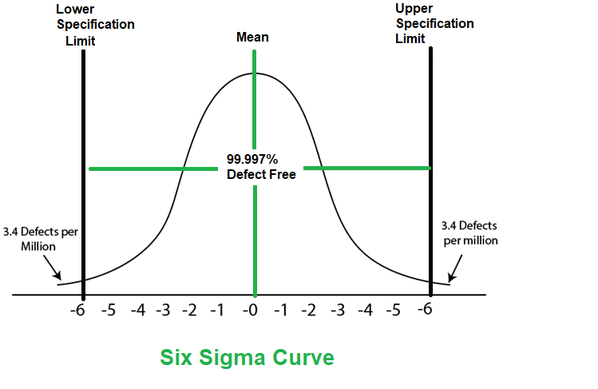
Six Sigma is the process of producing high and improved quality output. This can be done in two phases – identification and elimination. The cause of defects is identified and appropriate elimination is done which reduces variation in whole processes. A six sigma method is one in which 99.99966% of all the products to be produced have the same features and are of free from defects.

Slide 16
Characteristics of Six Sigma: The Characteristics of Six Sigma are as follows:
Statistical Quality Control: Six Sigma is derived from the Greek Letter ? which denote Standard Deviation in statistics. Standard Deviation is used for measuring the quality of output.
Methodical Approach: The Six Sigma is a systematic approach of application in DMAIC and DMADV which can be used to improve the quality of production. DMAIC means for Design-Measure- Analyze-Improve-Control. While DMADV stands for Design-Measure-Analyze-Design-Verify.
Fact and Data-Based Approach: The statistical and methodical method shows the scientific basis of the technique.

Slide 17
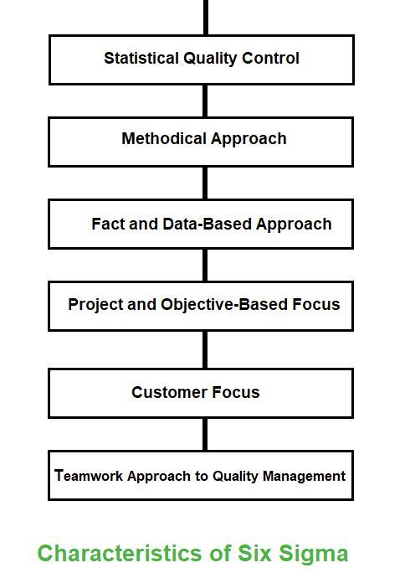

Slide 18
Project and Objective-Based Focus: The Six Sigma process is implemented to focus on the requirements and conditions.
Customer Focus: The customer focus is fundamental to the Six Sigma approach. The quality improvement and control standards are based on specific customer requirements.
Teamwork Approach to Quality Management: The Six Sigma process requires organizations to get organized for improving quality.

Slide 19
Six Sigma Methodologies: Two methodologies used in the Six Sigma projects are DMAIC and DMADV.
DMAIC is used to enhance an existing business process. The DMAIC project methodology has five phases:
Define
Measure
Analyze
Improve
Control
DMADV is used to create new product designs or process designs. The DMADV project methodology also has five phases:
Define
Measure
Analyze
Design
Verify

Slide 20
Computer Aided Software Engineering (CASE)

Slide 21
Computer-aided software engineering (CASE) is the implementation of computer-facilitated tools and methods in software development. CASE is used to ensure high-quality and defect-free software. CASE ensures a check-pointed and disciplined approach and helps designers, developers, testers, managers, and others to see the project milestones during development.
CASE can also help as a warehouse for documents related to projects, like business plans, requirements, and design specifications. One of the major advantages of using CASE is the delivery of the final product, which is more likely to meet real-world requirements as it ensures that customers remain part of the process.
CASE illustrates a wide set of labor-saving tools that are used in software development. It generates a framework for organizing projects and to be helpful in enhancing productivity. There was more interest in the concept of CASE tools years ago, but less so today, as the tools have morphed into different functions, often in reaction to software developer needs. The concept of CASE also received a heavy dose of criticism after its release.

Slide 22
CASE Tools: The essential idea of CASE tools is that in-built programs can help to analyze developing systems in order to enhance quality and provide better outcomes. Throughout the 1990, CASE tool became part of the software lexicon, and big companies like IBM were using these kinds of tools to help create software.
Types of CASE Tools:
Diagramming Tools: It helps in diagrammatic and graphical representations of the data and system processes. It represents system elements, control flow and data flow among different software components and system structures in a pictorial form. For example, Flow Chart Maker tool for making state-of-the-art flowcharts.
Computer Display and Report Generators: These help in understanding the data requirements and the relationships involved.

Slide 23
Analysis Tools: It focuses on inconsistent, incorrect specifications involved in the diagram and data flow. It helps in collecting requirements, automatically check for any irregularity, imprecision in the diagrams, data redundancies, or erroneous omissions. For example:
(i) Accept 360, Accompa, CaseComplete for requirement analysis.
(ii) Visible Analyst for total analysis.
Central Repository: It provides a single point of storage for data diagrams, reports, and documents related to project management.
Documentation Generators: It helps in generating user and technical documentation as per standards. It creates documents for technical users and end users. For example, Doxygen, DrExplain, Adobe RoboHelp for documentation.
Code Generators: It aids in the auto-generation of code, including definitions, with the help of designs, documents, and diagrams.

Slide 24
Advantages of the CASE approach:
As the special emphasis is placed on the redesign as well as testing, the servicing cost of a product over its expected lifetime is considerably reduced.
The overall quality of the product is improved as an organized approach is undertaken during the process of development.
Chances to meet real-world requirements are more likely and easier with a computer-aided software engineering approach.
CASE indirectly provides an organization with a competitive advantage by helping ensure the development of high-quality products.
It provides better documentation.
It improves accuracy.
It provides intangible benefits.
It reduces lifetime maintenance.
It is an opportunity to non-programmers.
It impacts the style of working of the company.
It reduces the drudgery in software engineer’s work.
It increases the speed of processing.
It is easy to program software.

Slide 25
Disadvantages of the CASE approach:
Cost: Using a case tool is very costly. Most firms engaged in software development on a small scale do not invest in CASE tools because they think that the benefit of CASE is justifiable only in the development of large systems.
Learning Curve: In most cases, programmers’ productivity may fall in the initial phase of implementation, because users need time to learn the technology. Many consultants offer training and on-site services that can be important to accelerate the learning curve and to the development and use of the CASE tools.
Tool Mix: It is important to build an appropriate selection tool mix to urge cost advantage CASE integration and data integration across all platforms is extremely important.

Slide 26
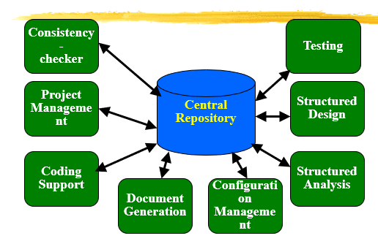
Schematic representation of architecture of CASE environment

